Slide 1

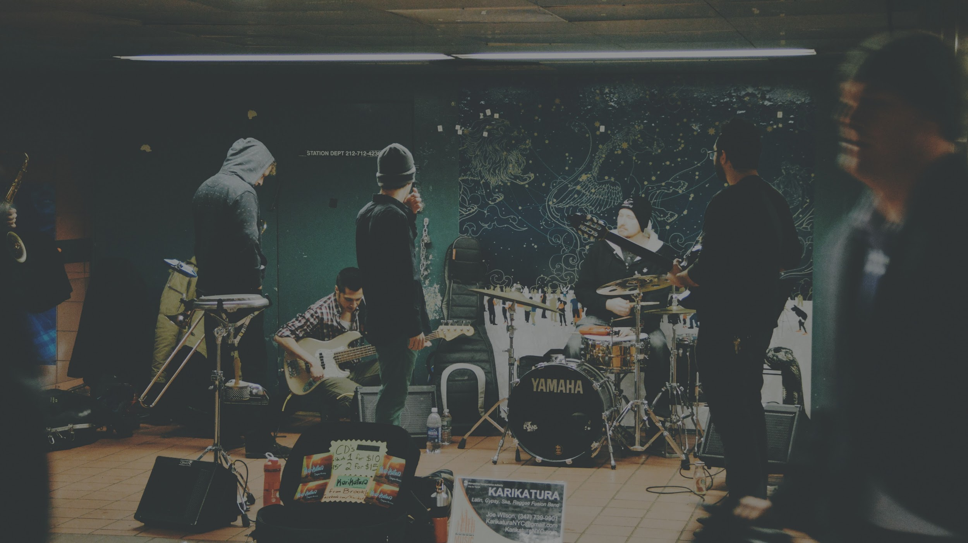
Nashville Music Map
Geoff Ren, Shaon Borosha, and Shamita Nagalla
Notes:
(a) application overview, perhaps opening with a grand vision and summarizing the functional specification, perhaps with illustrations, but minimally with slide deck of bullet items;
(b) an overview of the design, with a focus on the UML, highlighting different parts of the design, and highlighting relationships between the design and the functional specification;
(c) a demo of selected queries on a small sample database; and
(d) a very brief summary of future directions that this project could develop.
The presentations can be in Powerpoint, Prezi, or pdf -- let me know if you have another preference. You will use one of your group member's laptop. There should be a cover slide, followed by slides for part (a), which would probably correspond to a slide or two of bullet items; (b) might correspond to two+ slides, one or all featuring (parts of) the UML as an overview; (c) several slides with precomputed sample queries (a live demo of queries in fine, but practice it ahead of time), and (d) a bullet list of future directions. You can deviate from these specifications somewhat, and I encourage you to be creative, but the real purpose (beyond giving you a live presentation opportunity) is as a trial run for your video, which is the real goal of this coming week.

Slide 2
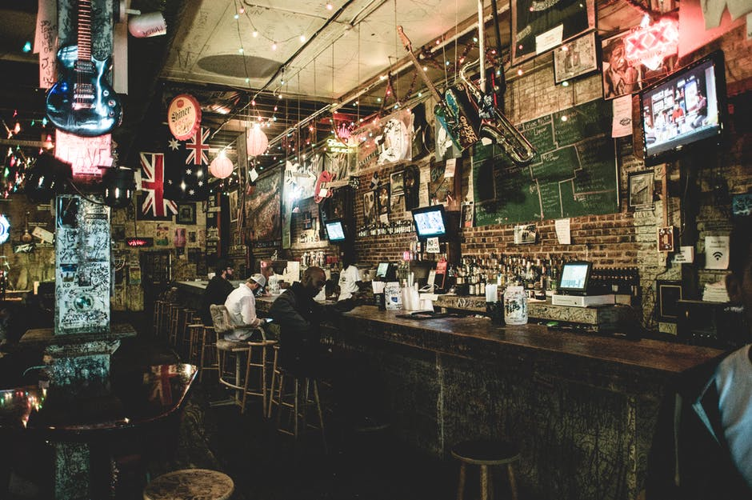
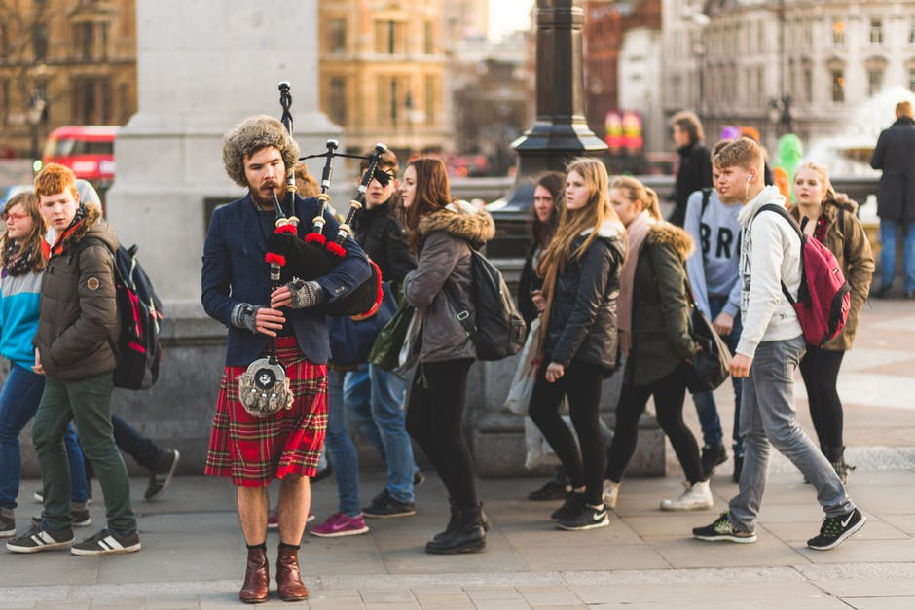
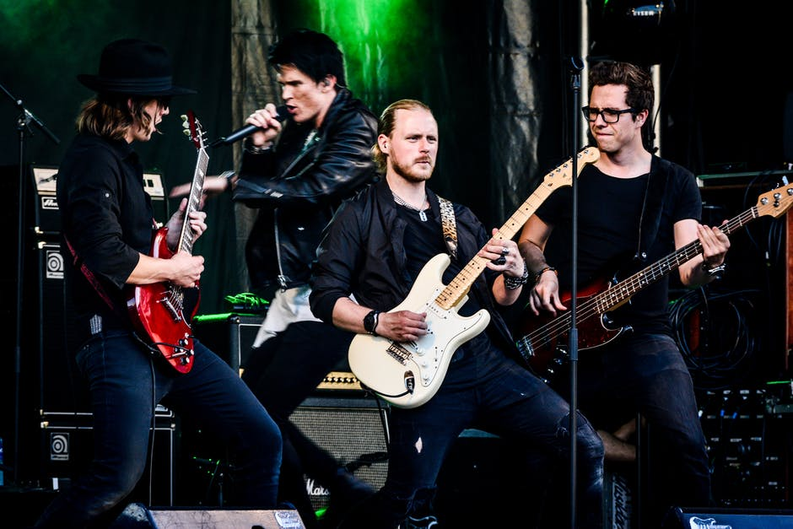
Music City

Slide 3

Web Application:
We will create a calendar that lists local events and related details

Slide 4

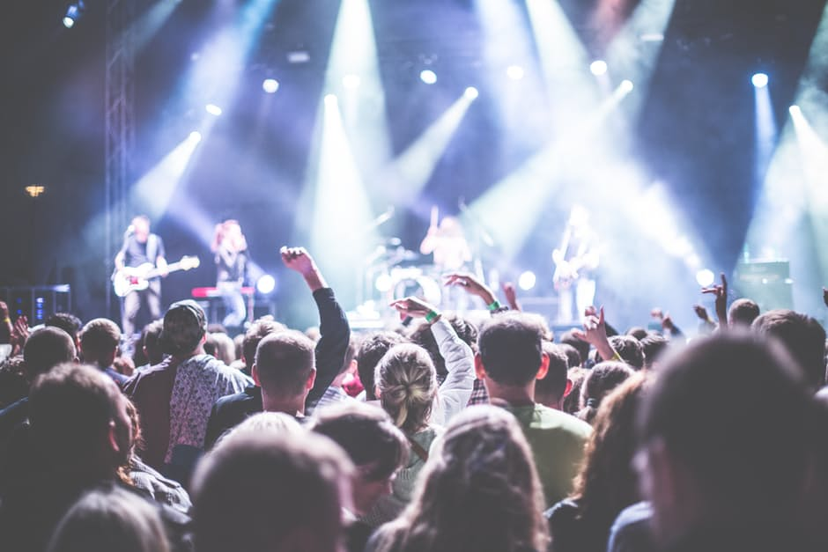
The app makes it easy
from your computer ………..…………… to the concert.

Slide 5


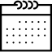



Functional Specifications
Information about venue
Information about performers
Information about events
Comments
Ratings
Bookmarks

Slide 6
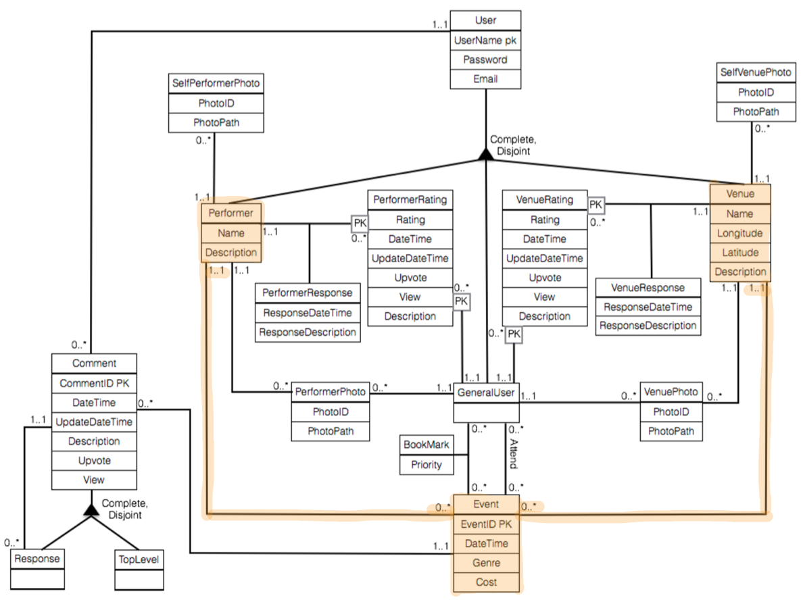
Information about venue
Information about performers
Information about events
Notes:
User separated into performer, venue, generaluser. Generaluser needed to include functionality only the public will use.
Venues will be described by name, location, description, photos, and user ratings
Performers will be described by name, description, photos and user ratings
Events will be described by date, genre, cost, performer, and venue
To support venue and performer descriptions, venue and performer tables will store all the needed information. An event table will also store all necessary event information as well as contain a reference to the performer and venue the event will be taking place at.
An event can only take place at one venue and have one performer on one day which is a limitation of the database. This app was only intended for small events, though, so this is fine for what we’re doing.

Slide 7
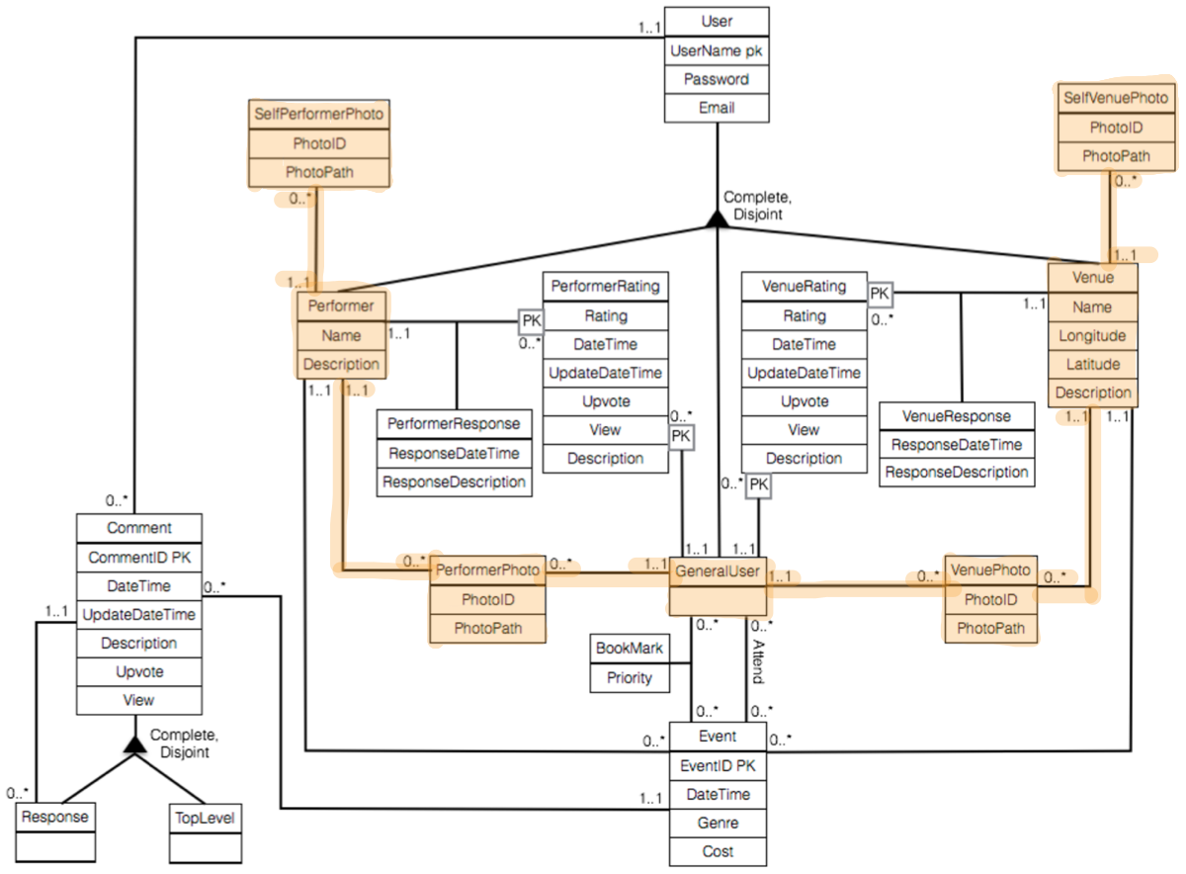
Information about venue
Information about performers
Notes:
Four different photo tables exist in the database, two for performers and two for venues. The two types of photo tables are for photos uploaded by users and for photos uploaded by the performer or venue.
This is so that the photos that the venue or performer wants you to see will be highlighted.

Slide 8
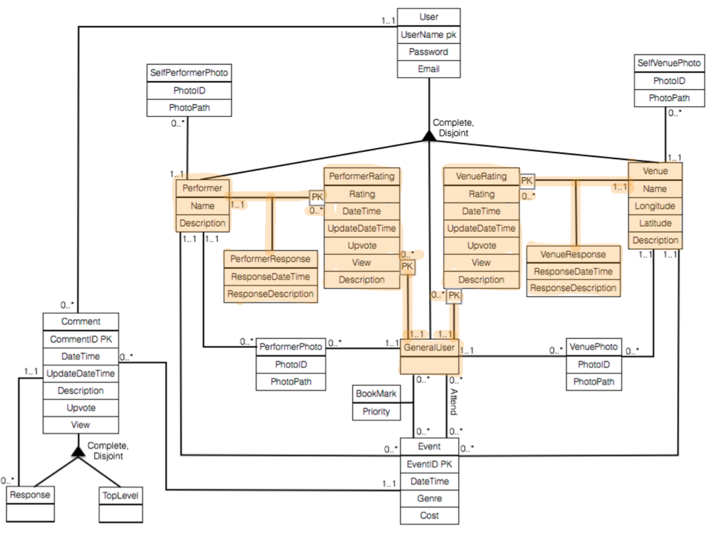
Ratings
Notes:
Users can rate performers and venues once as well as judge other ratings with an upvote system
Performers and venues will be able to respond to ratings both positive & negative
So that a User can only rate a performer or venue once, the performer and venue rating tables have a primary key containing the User performing the rating, and the entity being rated. The rating tables also contain information such as total number of upvotes and views to support functionality for users to judge other user’s ratings. Finally, the rating tables contain two columns that represent a performer or venue’s response to the rating. These can be null so that a performer or venue doesn’t need to respond to every rating.

Slide 9
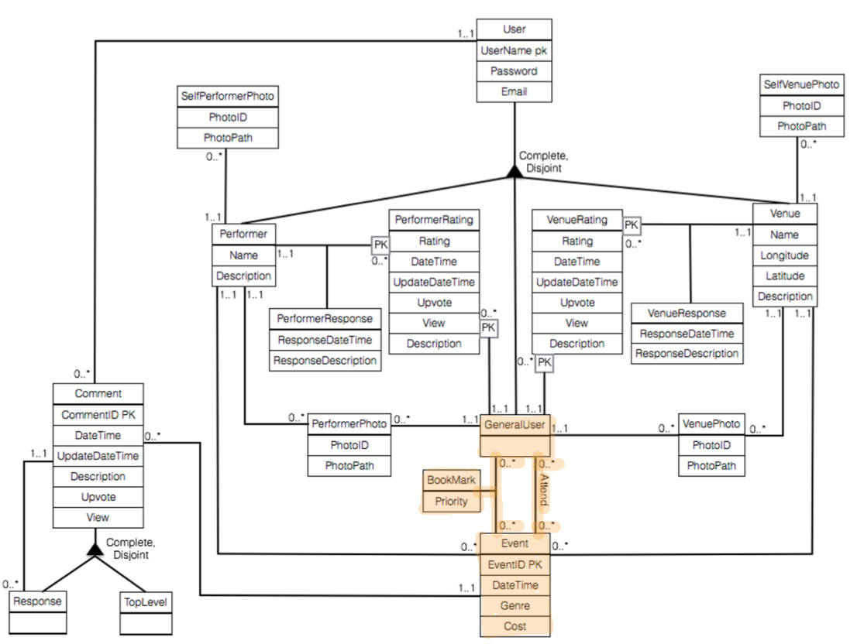
Bookmarks
Notes:
Users will also be able to bookmark events and see a history of past attended events
When a user attends an event, if that event exists in their bookmarks, it is removed from the bookmarks.
Only events in the future can be bookmarked

Slide 10
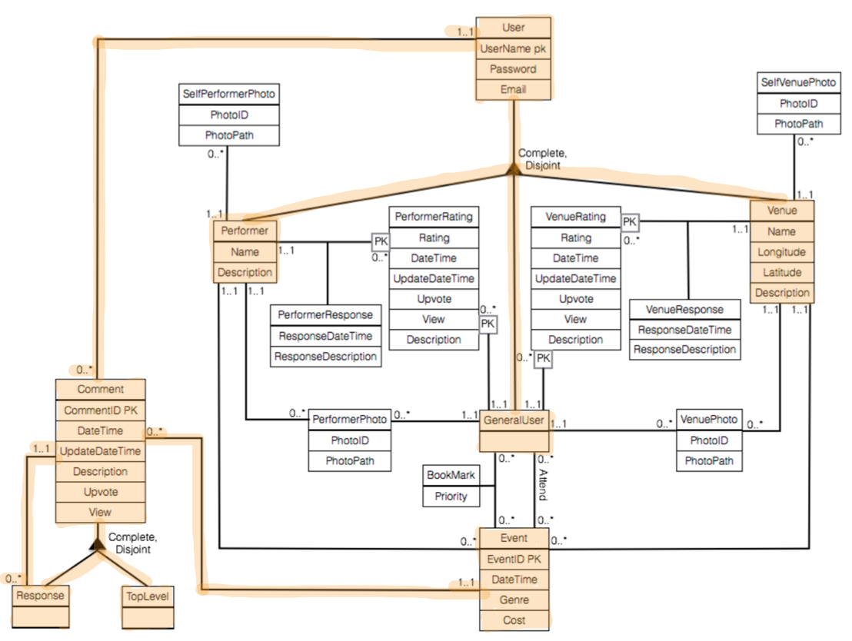
Comments
Notes:
Users, performers, and venues will be able to have a conversation about each event
Comments are split into two classes: top level and responses. The difference between these two is that responses contain a reference to the comment parent class. This allows responses to be responses to a top level or response. Top level is its own class to easily identify top level comments.
Performers, general users, and venues all belong to the same parent class which allows all of them to participate in comments. This makes sense because comments are only made in the scope of events which is supported by the 1..1 reference between comments and events.

Slide 11
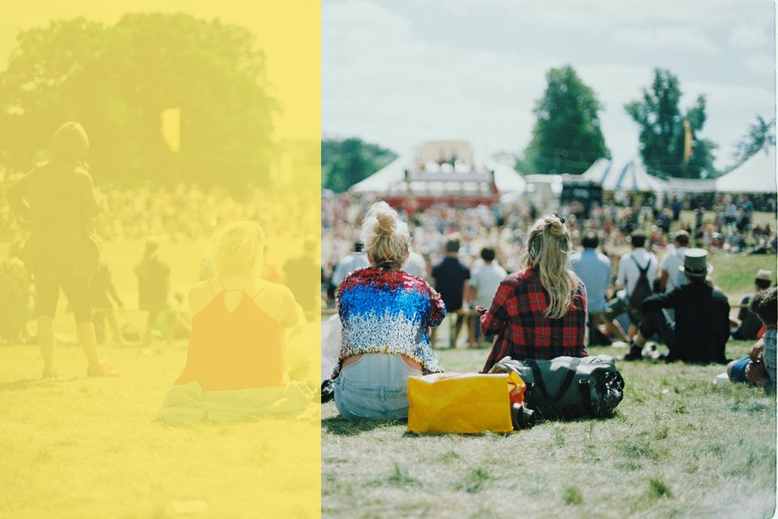



Future Directions
Show information for more types of events
Have previews and highlights from different artists
Allow ticket sales and reservations to be made online

Slide 12
Images
https://www.pexels.com/photo/band-concert-drum-drummer-300333/
http://www.clker.com/clipart-white-world-map-outline.html
https://clipartfest.com/categories/view/4f7442a784e73536c06be406fcf9f514cb9e7fae/computer-outline-clipart.html
Icons:
Bookmark: Icon made by Madebyoliver from flaticon.com
Thumbs Up: Icon made by Gregor Cresnar from flaticon.com
Comments: Icon made by Gregor Cresnar from flaticon.com
Calendar: Icon made by Madebyoliver from flaticon.com
Microphone: Icon made by Freepik from flaticon.com
Map: Icon made by Madebyoliver from flaticon.com
Info Box: Icon made by Madebyoliver from flaticon.com
Camcorder: Icon made by Hanan from flaticon.com
Ticket: Icon made by Dave Gandy from flaticon.com
Paintboard: Icon made by Freepik from flaticon.com
Slide 5 Computer: https://www.pexels.com/photo/person-using-laptop-computer-during-daytime-196655/
Slide 5 Concert: https://www.pexels.com/photo/crowd-in-front-of-people-playing-musical-instrument-during-nighttime-196652/
Final Slide: https://www.pexels.com/photo/3-woman-sitting-on-green-grass-field-facing-the-gathering-people-during-daytime-165853/

